Slide 1
World University Ranking
--with detailed metrics
--By looking into the world university rankings and the metrics behind, we aim to help upcoming college applicants to choose their preferred colleges and help colleges find ways to improve.
Member: Ziyi Gao, Shimin Liang, Binxing Li, Yuxin Tang

Slide 2
Business Backgrounds
Student Perspective
-- Help potential college applicants determine which country and university to apply according to the metrics for each school.
School Perspective
-- Understand metric scores behind the college’s ranking, and determine where to improve for a better ranking in the future.

Slide 3
2. Exploratory Data Analysis (EDA)

Slide 4
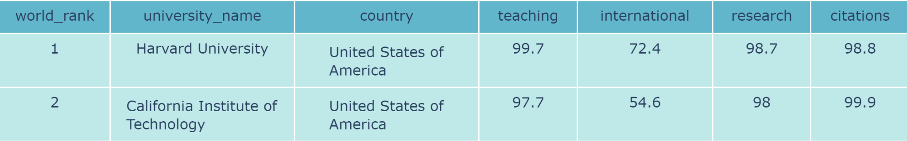
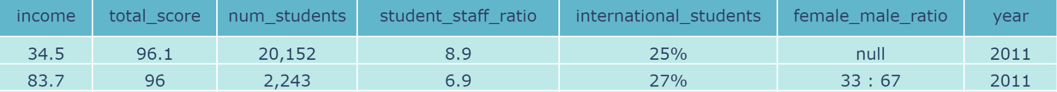
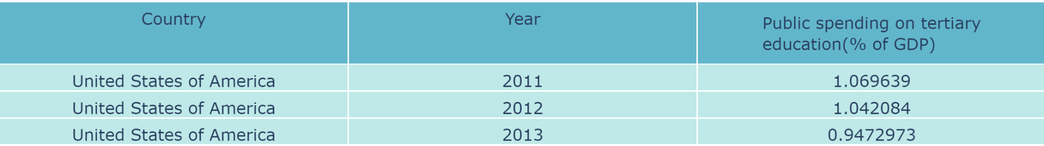
2-1 Datasets
1
2
Notes:
Public spending on education includes direct expenditure on educational institutions as well as educational-related public subsidies given to households and administered by educational institutions. This indicator is shown as a percentage of GDP, on tertiary education,shows the priority given by governments to education relative to other areas of investment, such as health care, social security, defence and security.

Slide 5
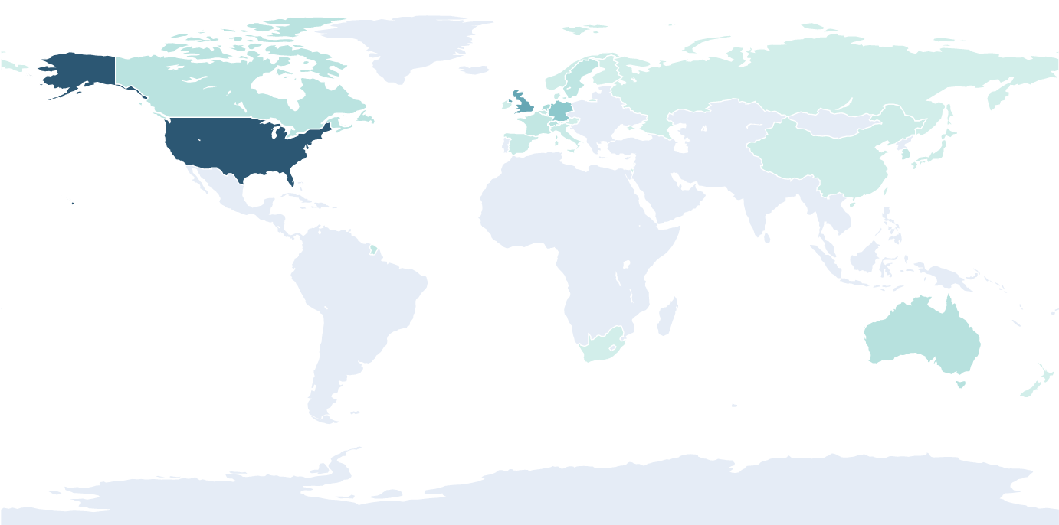
2-2. Country & Number of Universities (2016)
--United States has the highest number of Top ranking universities
--Some European Countries also have several high ranking universities
--By comparing with other year’s result, we can find the trend’s minor changes annually
Distribution of top 200 ranking universities in 2016

Slide 6
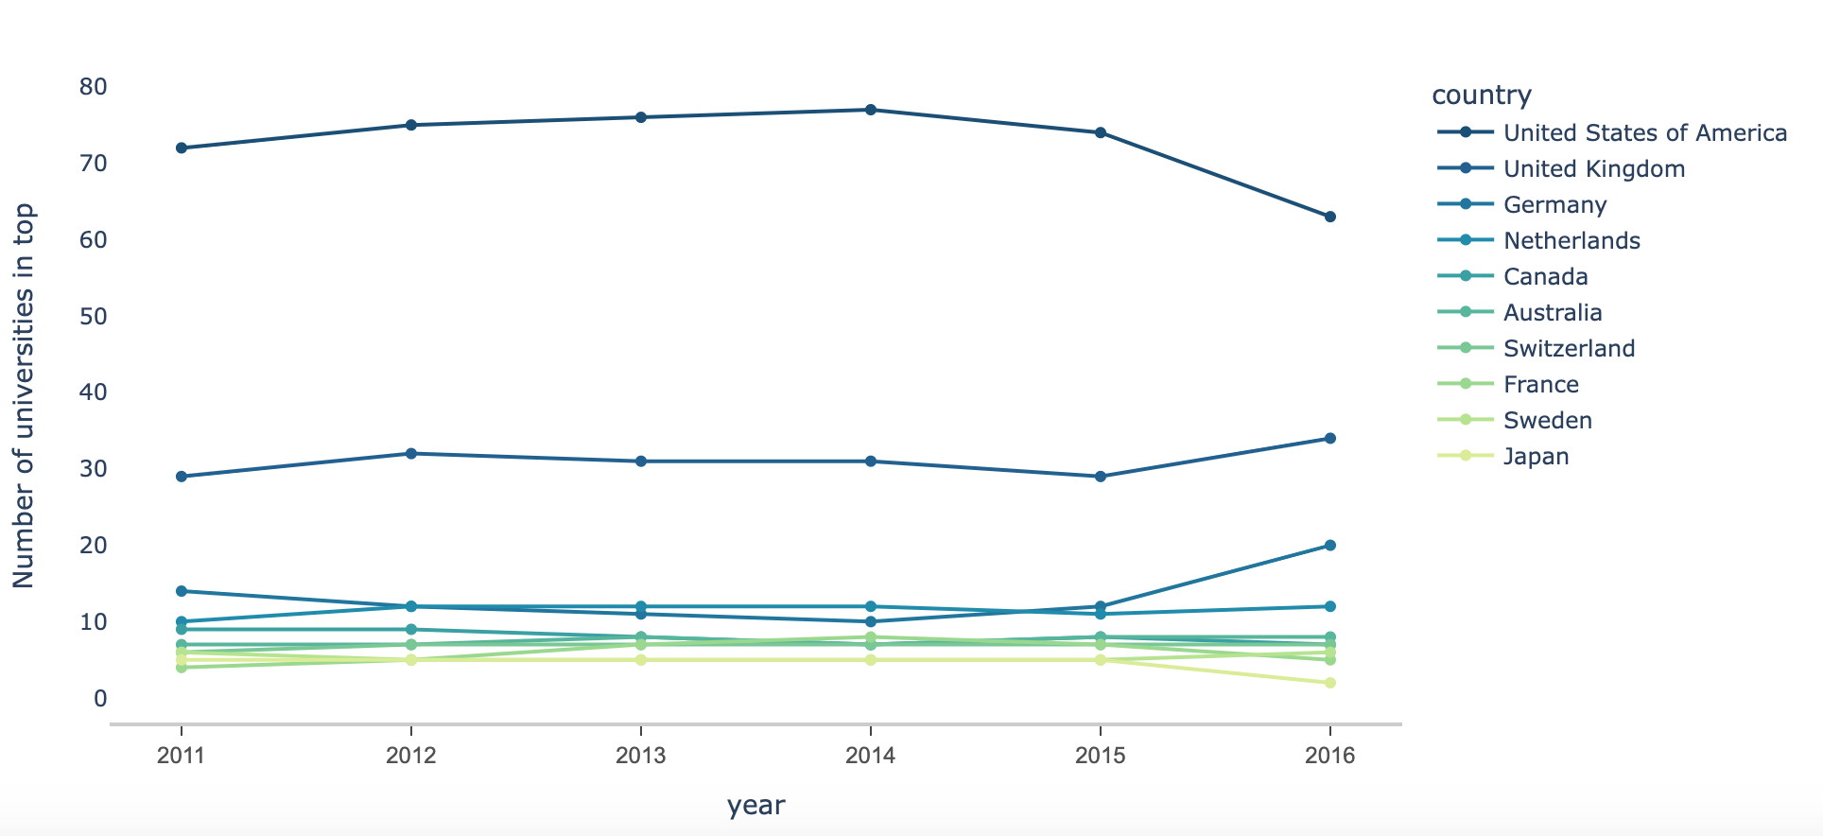
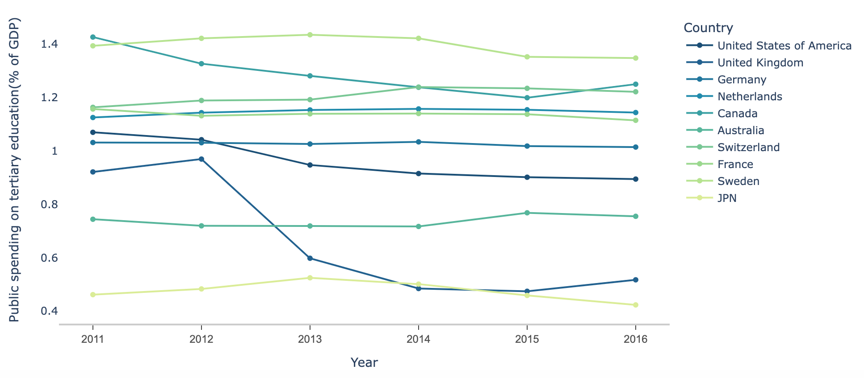
2-2. Country & Number
& Expenditure of Universities
We selected Top 10 countries who have highest number universities on list for further data exploration
-- United States kept its top ranking with the highest number of top ranking universities consecutively, but the number slightly decreased in 2016
-- By comparing with the expenditure, we can see the relationship between the expenditure and the number of top ranking universities is not strong.
10
Notes:
However, because the expenditure used here is as the percentage of GDP, the

Slide 7
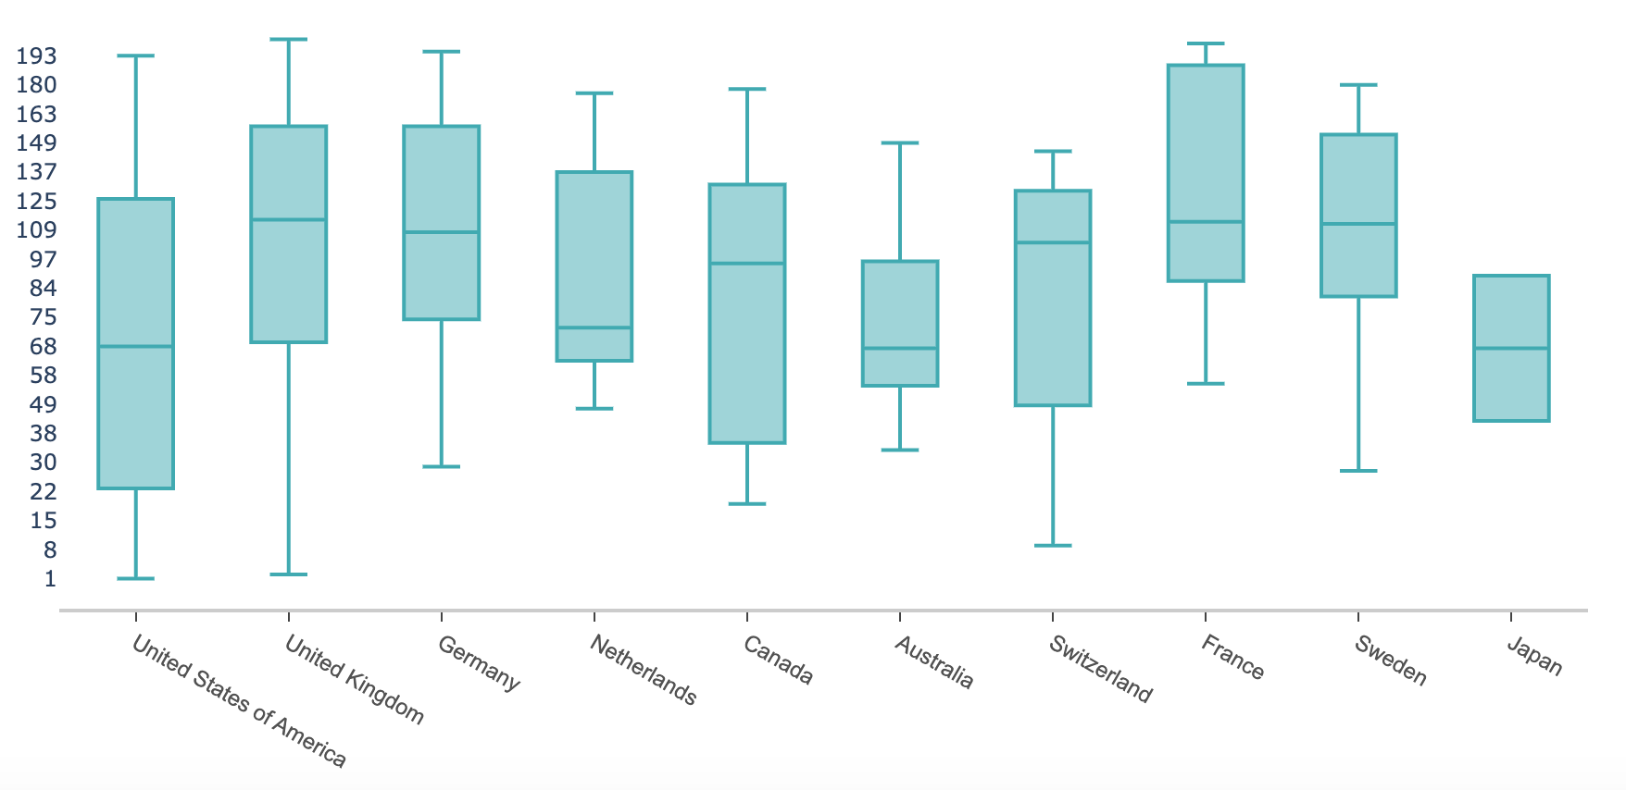
2-3. Top 10 Countries’ Universities’
Ranking Distribution (2016)
-- United States and United Kingdom both have high range of rankings comparing to other countries
-- Although Japan does not have many universities included, their ranked universities are more highly ranked.
Notes:
This is the ranking distribution of each top 10 countries’ universities. The ranges shows the highest and lowest rank of universities in the country. The interquartile parts can tell us the position that most number of universities in the country was located. From this, we found the result being quite interesting that although united states and united kingdom both have very high ranging universities, the universities in United States are more concentrated in higher ranked positions. It is also interesting to see that Although Japan does not have many universities included, their ranked universities are also more highly ranked.

Slide 8
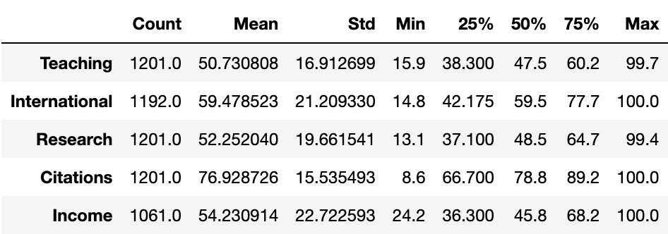
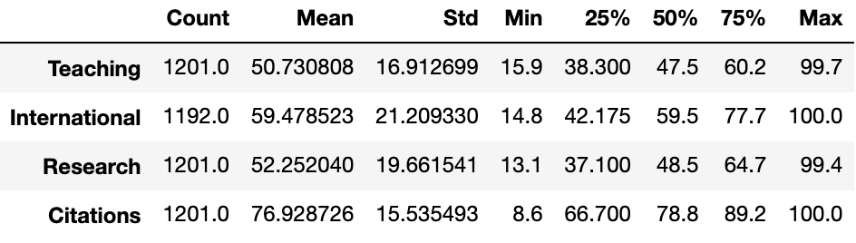
2-4. Score Metrics Description
-- These are the detailed statistics of the metrics used for the ranking.
(200 schools for 6 years)
-- The distributions for all 4 metrics are all roughly symmetrical.
-- The citation scores are higher than the others.
Notes:
These are the detailed statistics of the five metrics used for the ranking. Teaching represents the learning environment score, Research represents the research productivity, research income and the reputation of that.Citations represents the influence of the research.International represents the proportion of international students and staffs, and degree of international collaboration.Income represents the income score of the graduates.
Because the data includes 6 years and we choose 200 schools for analysis, the count is 1200. From these statistics, we can see The distributions for all 5 metrics are all roughly symmetrical, and The citation scores are higher than the others.

Slide 9
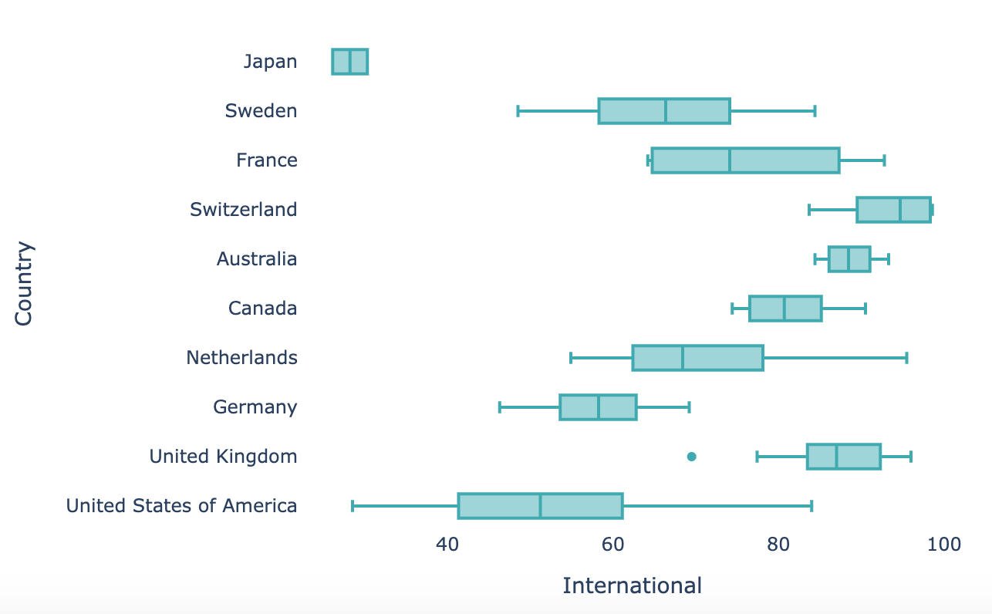
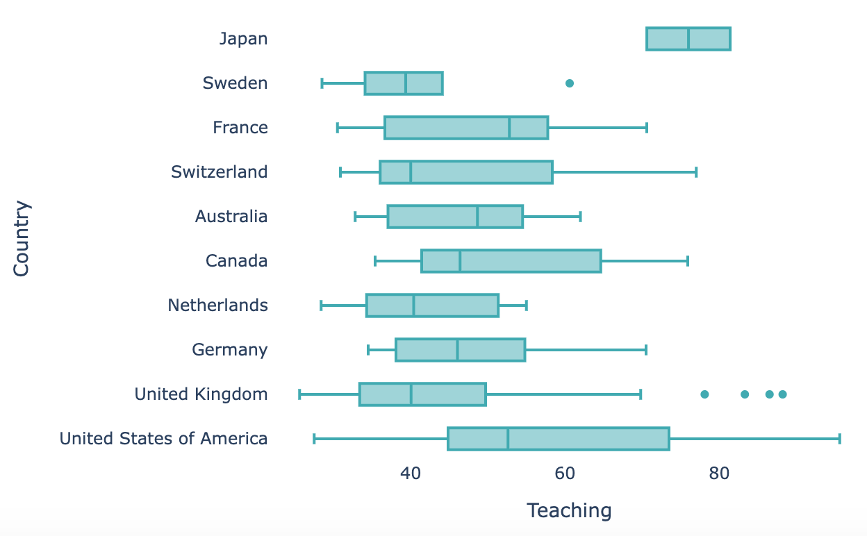
2-5. Top 10 Countries’ Metrics Distribution (2016)
These are the detailed metric distribution (International and Teaching) in top 10 countries.
International: Situations between countries are more varied compared to other metrics.
Teaching: Except Japan who has very high teaching score, most countries’ teaching scores are similar.
Notes:
By looking into details about the 5 metrics in each top 10 country, we found for international, the scores are more varied comparing to other metrics. For teaching, Except Japan who has very high teaching score, most countries’ teaching scores are similar.

Slide 10
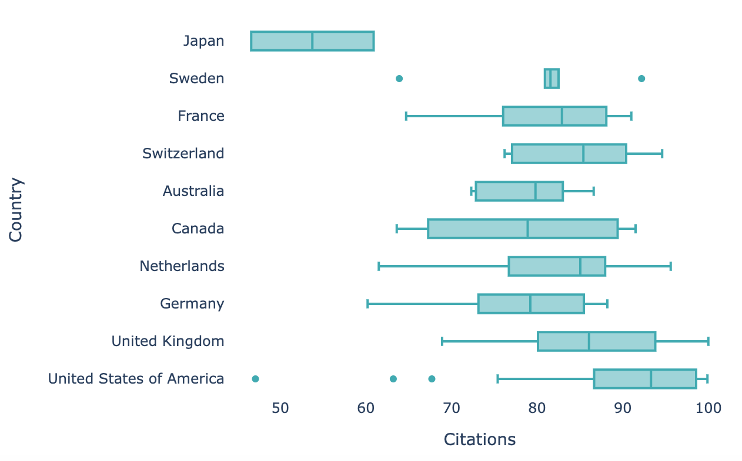
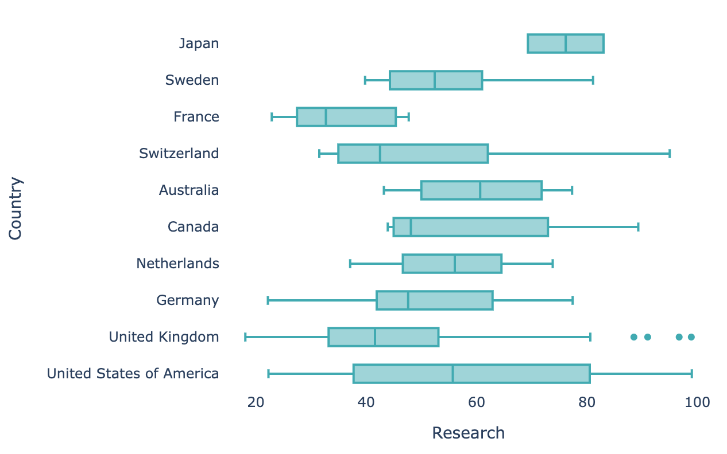
2-5. Top 10 Countries’ Metrics Distribution (2016)
These are the detailed metric distribution (Citations and Research) in top 10 countries.
Citations: Except Japan who has comparatively low scores, citations scores for other countries are more similar
Reach: Research score are more varied between countries, and United States’ scores has the highest range from 20 to almost 100.

Slide 11
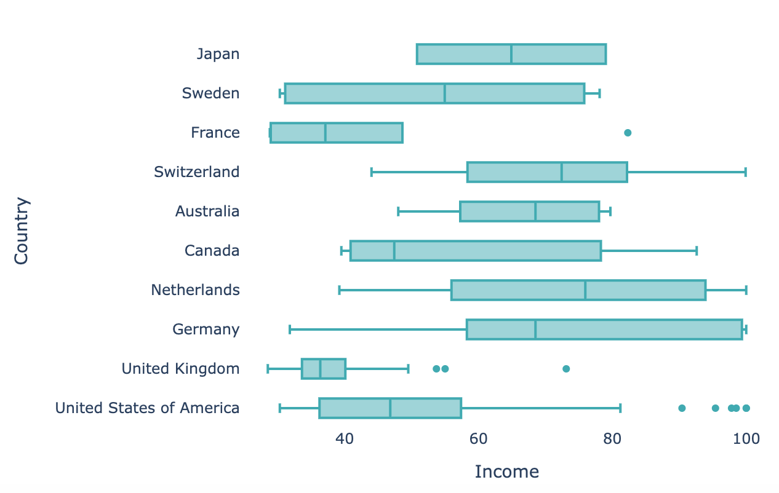
2-5. Top 10 Countries’ Metrics Distribution (2016)
These are the detailed metric distribution (Income) in top 10 countries.
Income: The income distribution is also varied across countries. However, European countries such as Netherlands, Germany, Switzerland all have higher maximum and average income score comparing to other countries.

Slide 12
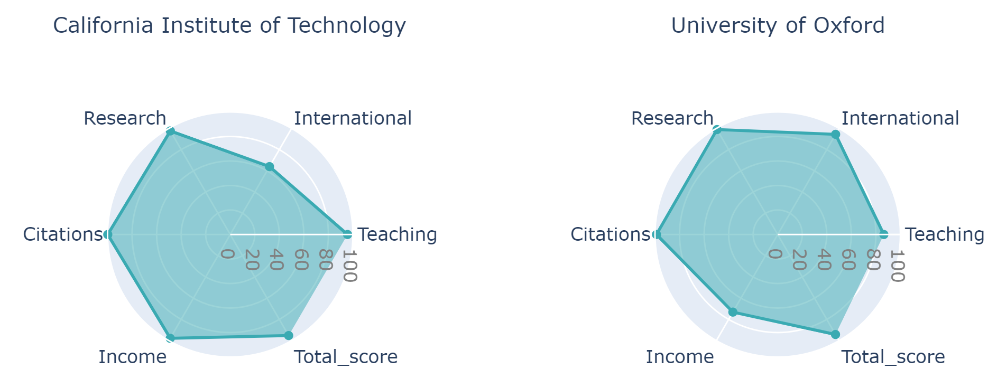
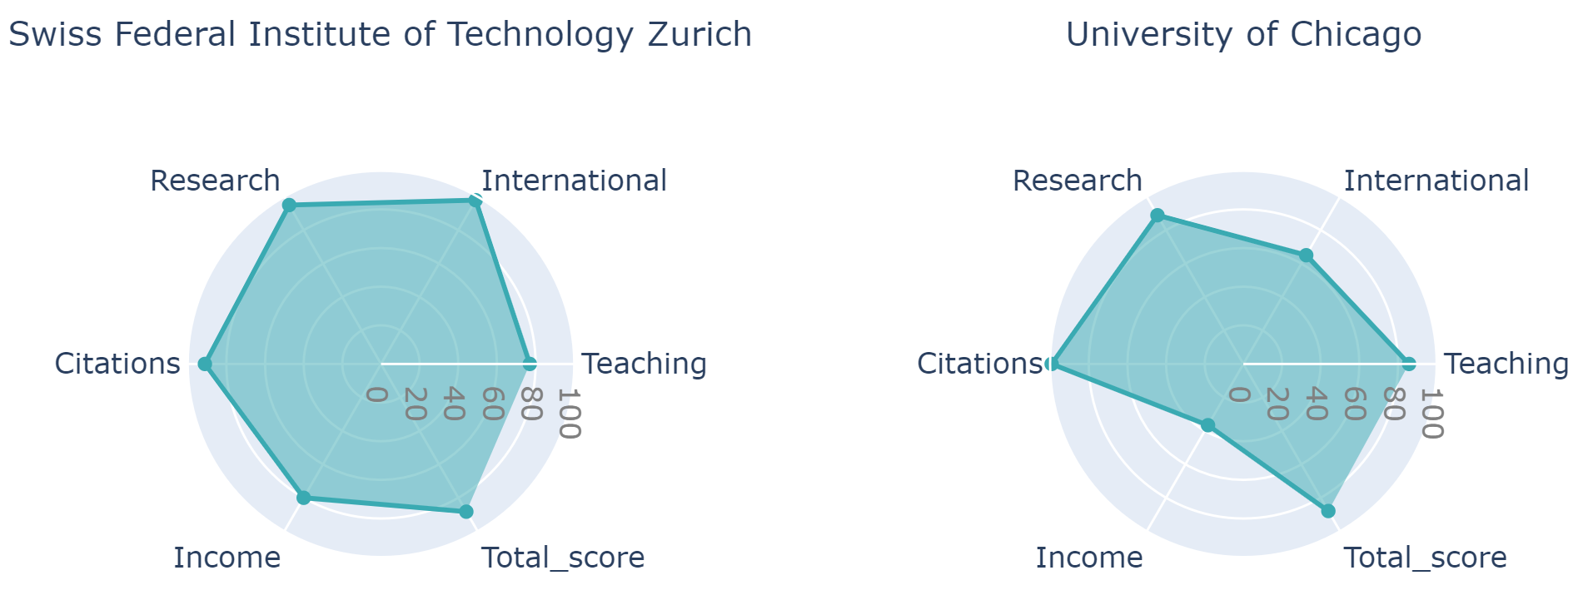
2-6. Top 10 Universities’ Metrics (2016)
1
2
-- Higher ranking universities have higher metrics scores on all the 5 metrics.
--California Institute of Technology (Top 1) have almost full score on research, citation, teaching, and income.
-- University of Chicago (10th) have relatively lower scores on the 5 metrics.
9
10
Notes:
Then, We also compare the metrics of each universities. We selected some of the world top 10 universities in 2016, and made comparisons between them. We found that as the world top 1 university, California Institute of Technology has very high scores on most of the metrics. Except for international, it reached almost 100 of all the other 4 metrics. Comparing to that, the University of Chicago, which ranked as the 10th, has comparatively lower score in average to the California Institute of Technology. We think if we can show all the universities’ metrics, it will be very useful for students to decide which university they want to apply. And for universities, they will now where to improve to have better ranking. Next binxing and Yuxin will show more about how we used these data on our dashboard to help the students and universities.

Slide 13
3. Dashboard

Slide 14
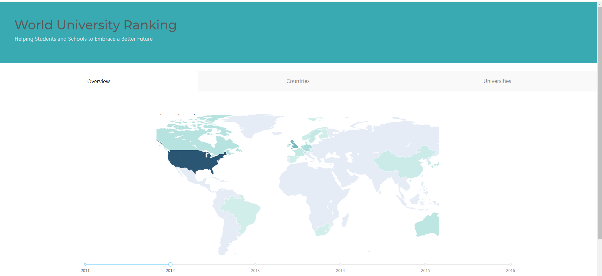
3-1. Overview
After choosing the year on the slider, a map will show how many universities a country have on list.
The overview tab mainly helps students to have a big picture of places to apply. For example, North America has most number of schools listed on the ranking and the ranks are more concentrated in higher ranks.

Slide 15
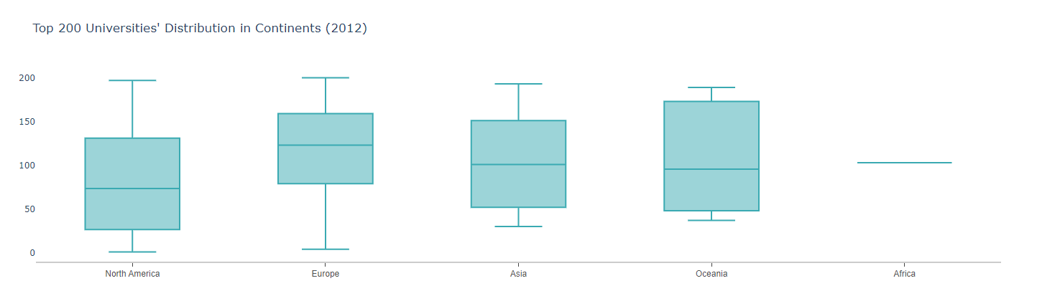
3-1. Overview
With the year selected for map, box plot showing the ranking distribution of the universities in each continent will be updated.

Slide 16
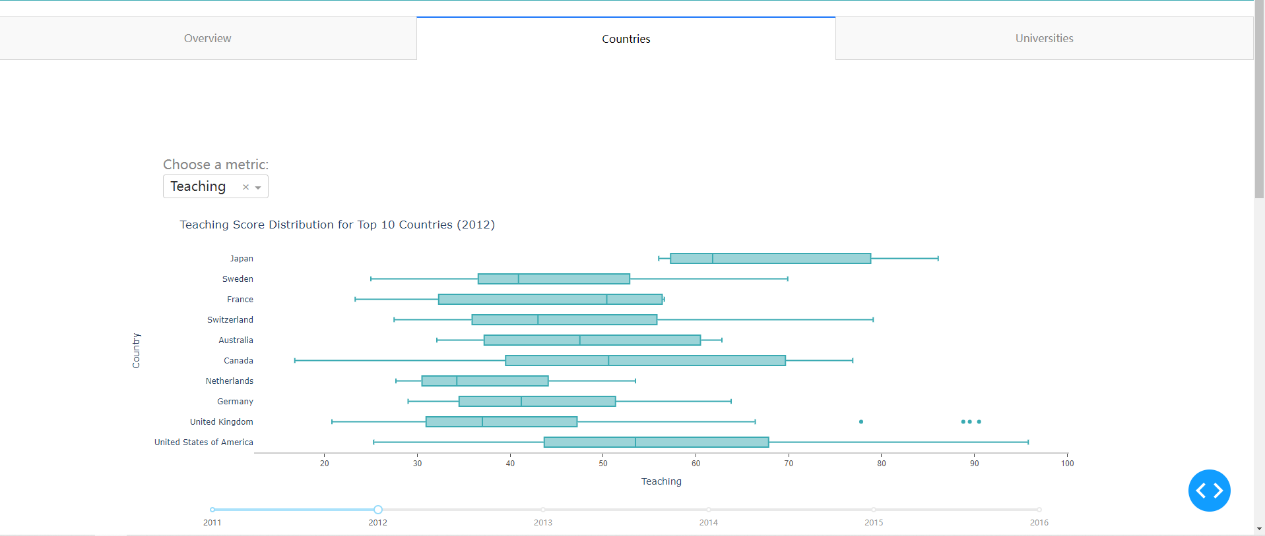
3-2. Country
Shows each year’s metric’s distribution for top 10 countries
The country tab mainly helps students to know which country to apply according to country’s universities ranking and their preferences of the metrics. The tab also helps schools to have big picture about their countries’ universities’ overall performance and the relationship between their country’s educational level and public expenditure.

Slide 17
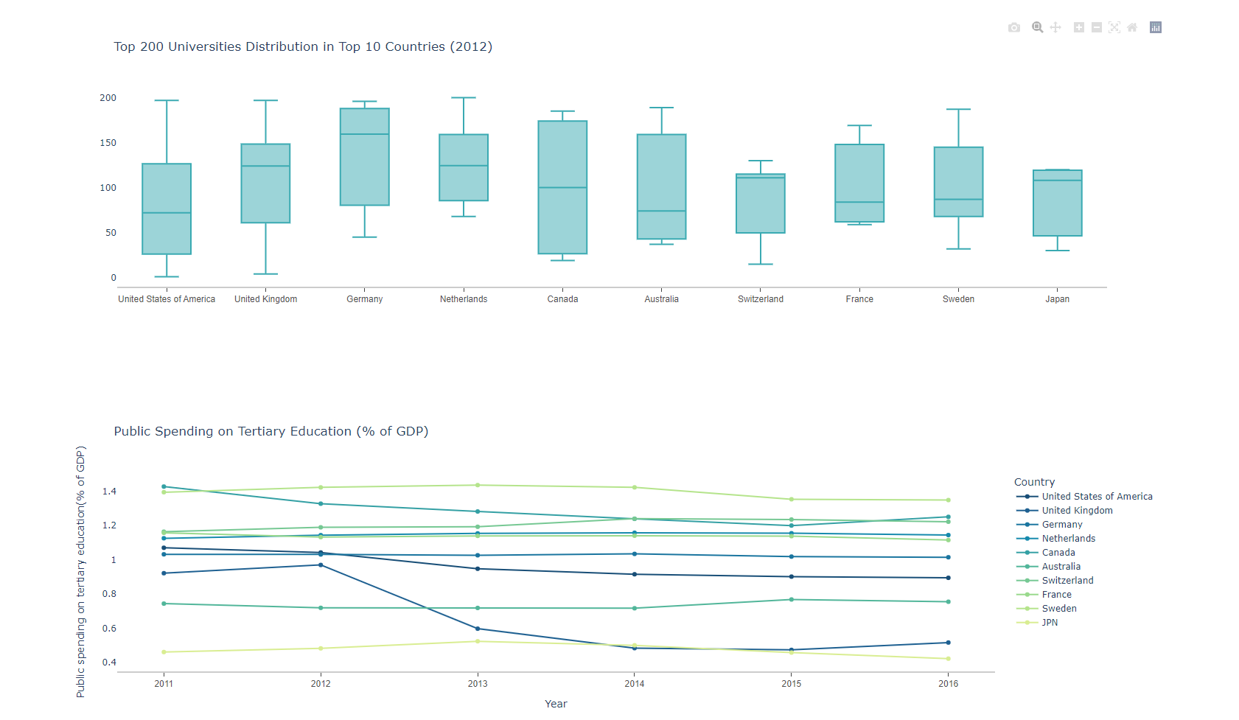
3-2. Country
Shows top 10 country’s universities ranking distribution
Shows top 10 country’s public expenditure changes

Slide 18
3-3. Universities
After selecting year, the year’s world top 10 universities’ metrics will be shown for comparison.
The universities tab mainly helps students to select which universities to apply according to the detailed metrics and historical ranking. It also helps universities to know where they should improve further to have better ranking in the future.

Slide 19
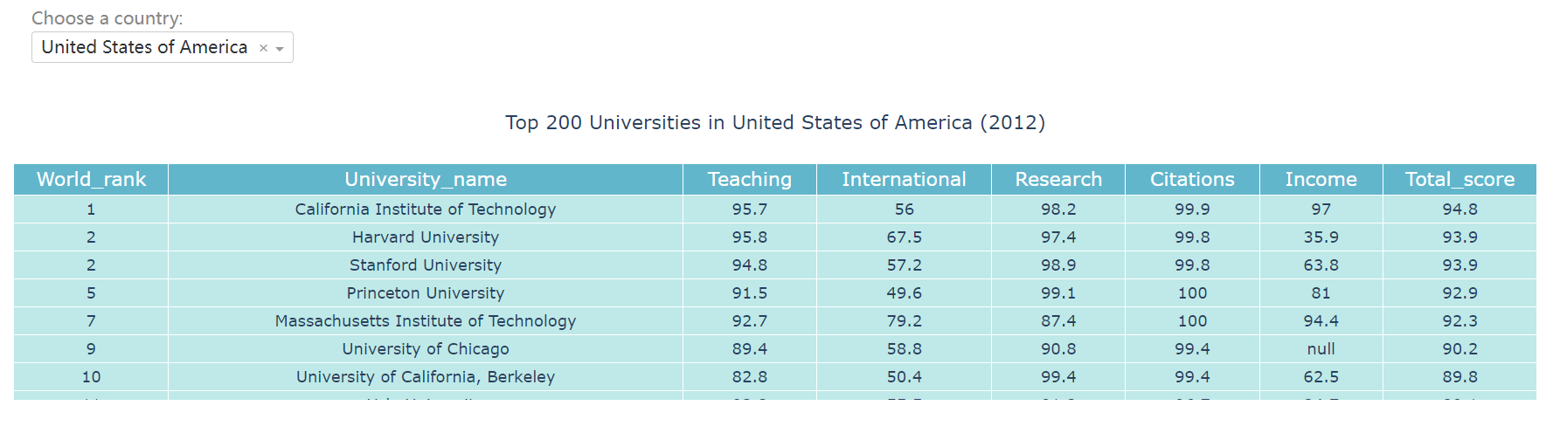
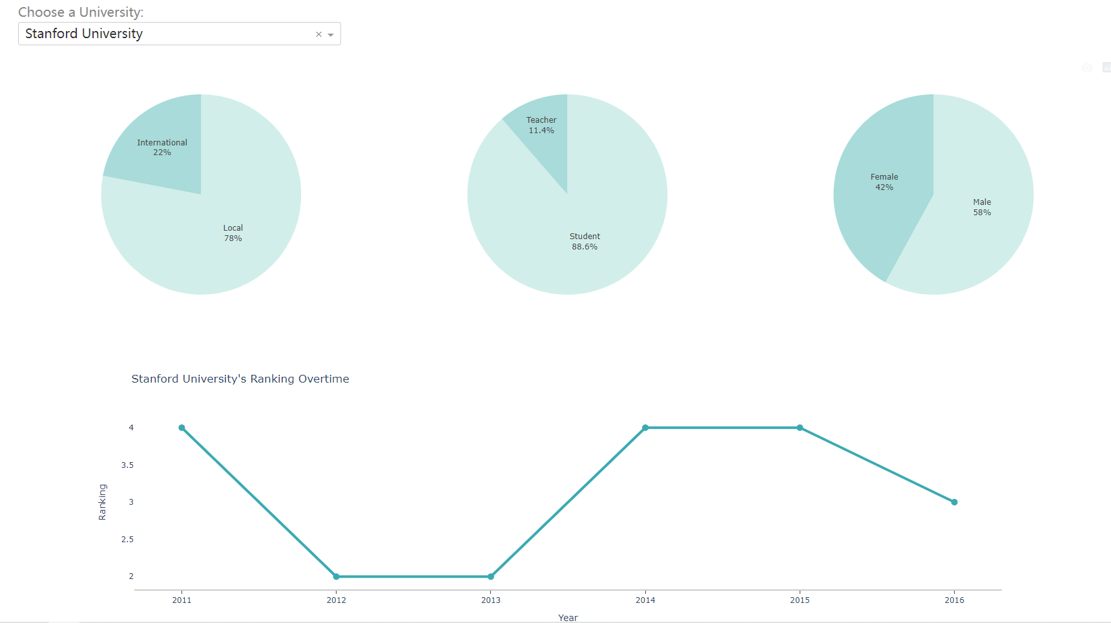
3-3. Universities
-- After selecting year and country, all universities are listed with detailed metrics
-- After selecting year, country, and university, other metrics such as teacher student ratio will be shown
--Lastly, the selected university’s historical rank will be shown

Slide 20
4. References
University Ranking Dataset:
https://www.kaggle.com/gpreda/world-university-rankings-advanced-analysis/data
Expenditure Dataset:
https://data.oecd.org/eduresource/public-spending-on-education.htm#indicator-chart

Slide 21
Thank You!

